Slide 1



A Numerical Study of Mesh Adaptivity in Multiphase Flows with Non-Newtonian Fluids
James Percival, Dimitrios Pavlidis, Zhihua Xie, Chris Pain
(Applied Modelling & Computation Group,
Earth Science & Engineering, Imperial College London)
Omar Matar (Chemical Engineering, Imperial College London)
Federico Alberini, Mark Simmons (University of Birmingham)
j.percival@imperial.ac.uk
APS DFD meeting
Monday 24th November 2014
San Francisco, California
Slides available from http://jrper.github.io/talks/APS-DFD2014

Slide 2
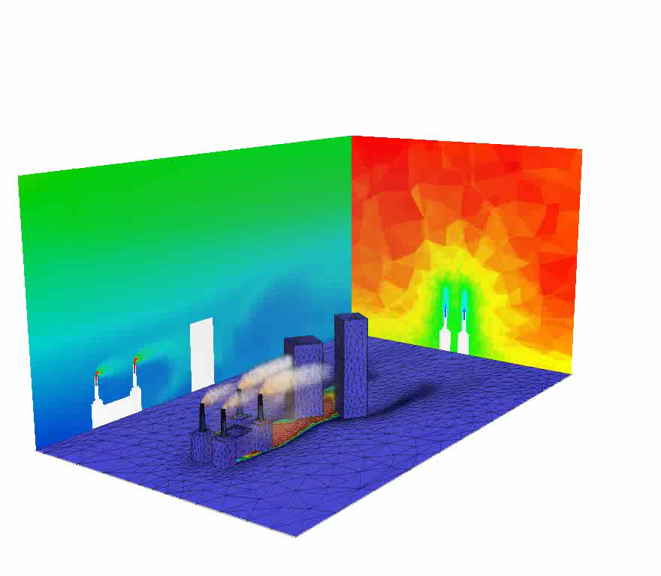
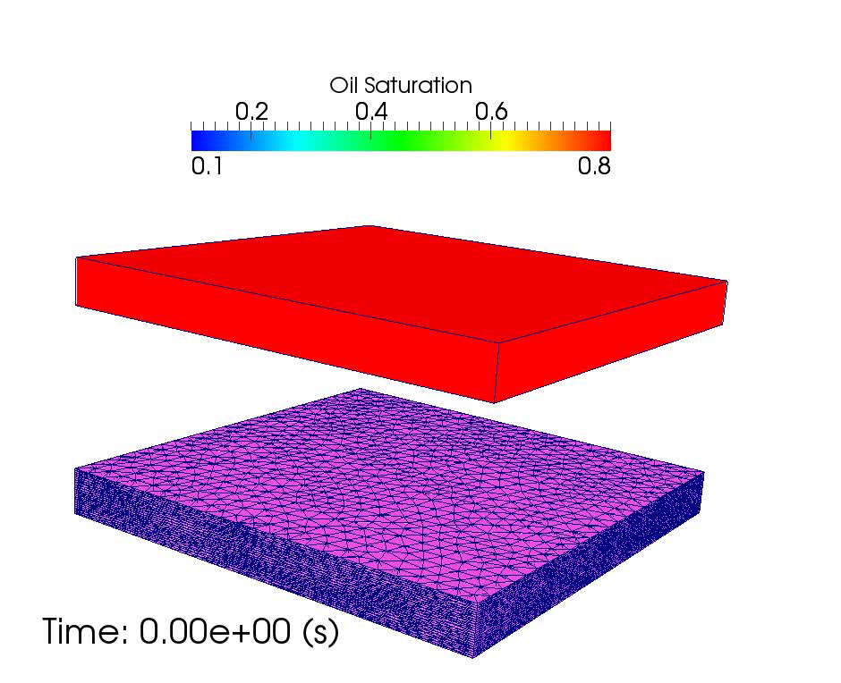
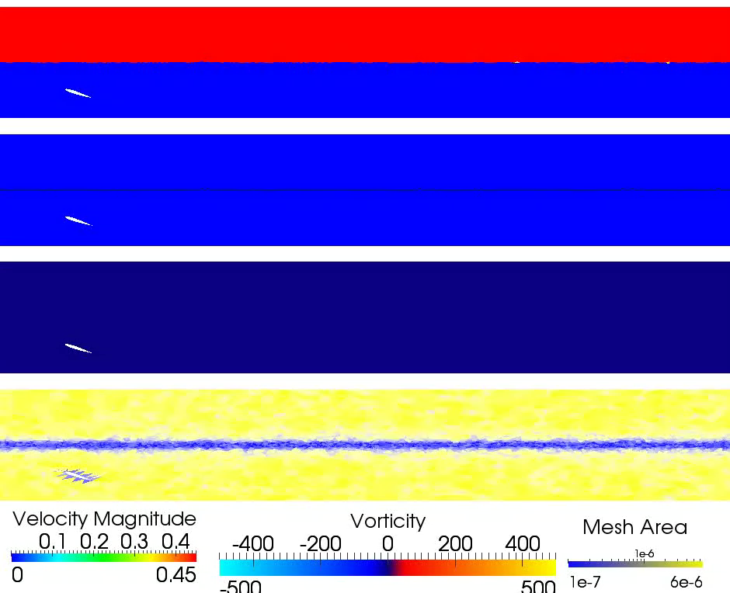
http://jrper.github.io/talks/APS-DFD2014
j.percival@imperial.ac.uk
Fluidity – a finite element flow simulator
(CV)FEM based
Navier-Stokes/Darcy flow solver framework
Mesh adaptivity capability on unstructured meshes
Parallelized [MPI/OpenMP]
Multimaterial & multiphase formulations (and both together)
Used for CFD, GFD and oil reservoir simulations
www.fluidity-project.org

Slide 3
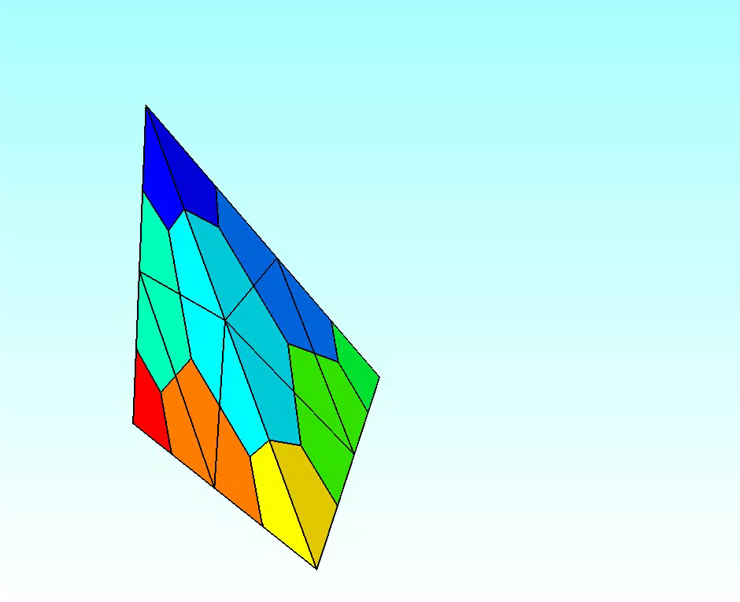
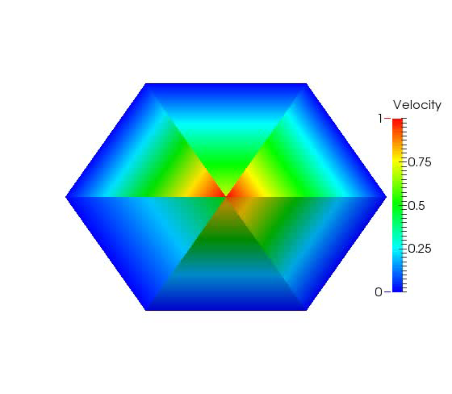
http://jrper.github.io/talks/APS-DFD2014
j.percival@imperial.ac.uk
Fluidity – multiphase implementation
Volume of fluid (VOF) approach for interface capturing.
Compressible advection for two phase (n-phase) indicator functions
Optimized for unstructured mesh modeling on simplices (triangles & tetrahedra).
Control volume- finite element method
Control volumes [phase indicator functions/phase volume fraction]
Finite elements [pressure/velocity]
Surface tension also implemented [Z. Xie. R33.1]
Multiple Rheologies:
Power law/Herschel Bulkley
Carreau
Viscoelastic (Oldroyd – B)
Pavlidis et. al IJMF(2014)
Xie et al. IJMF (2014)
Percival et al. IJMF (2014)

Slide 4
Fluidity – multiphase implementation
Equation Set
momentum
mass continuity
Indicator function
Implying either:
(incompressible)
(compressible)

Slide 5
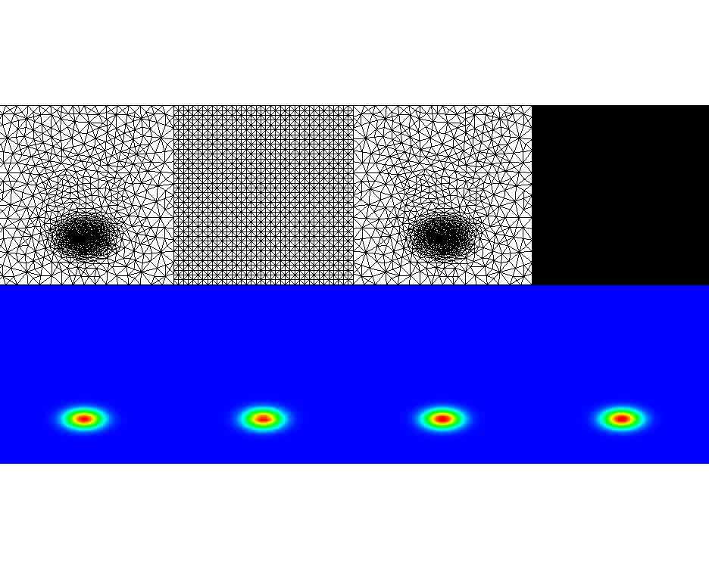
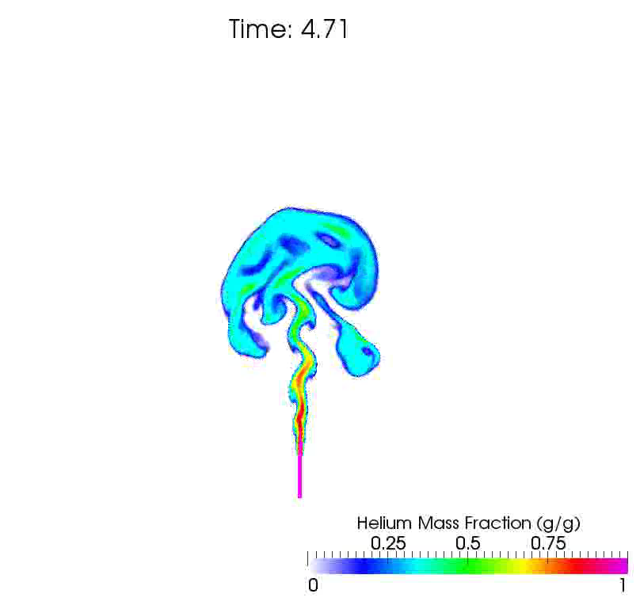
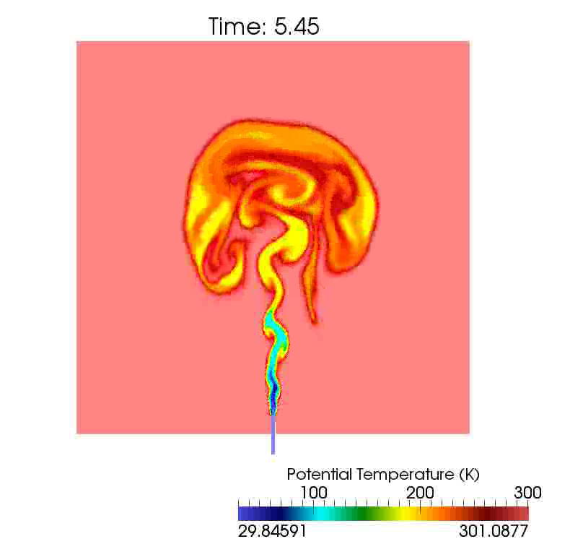
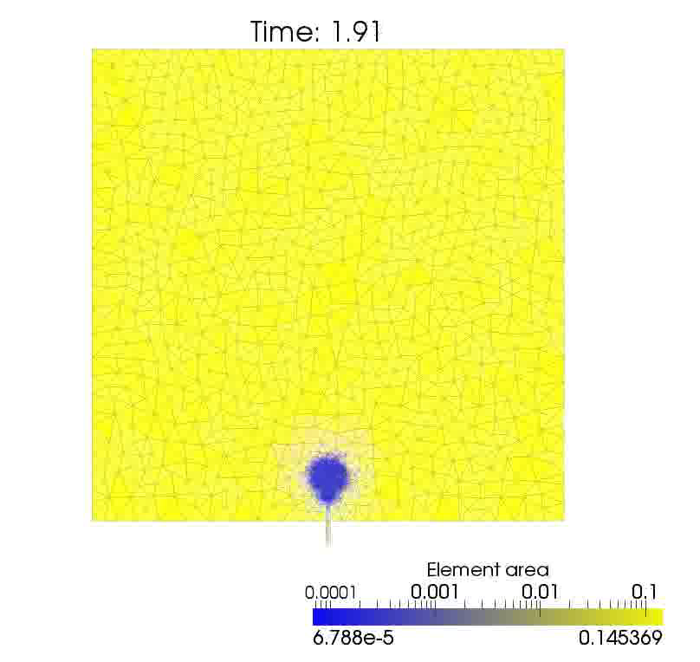
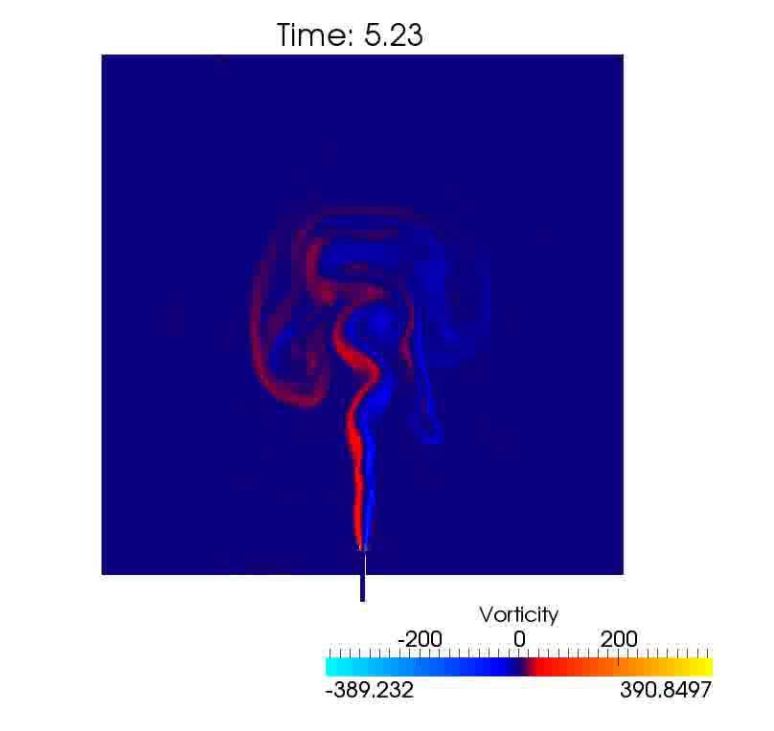
Mesh Adaptivity - examples
http://jrper.github.io/talks/APS-DFD2014
j.percival@imperial.ac.uk
Initial adaptive
mesh
Fixed
mesh 1
Adaptive
mesh
Fixed
mesh 2
Analytic
solution
Fixed
mesh 1
Adaptive
mesh
Fixed
mesh 2
2 orders of magnitude smaller problem/half error
30x speed up

Slide 6
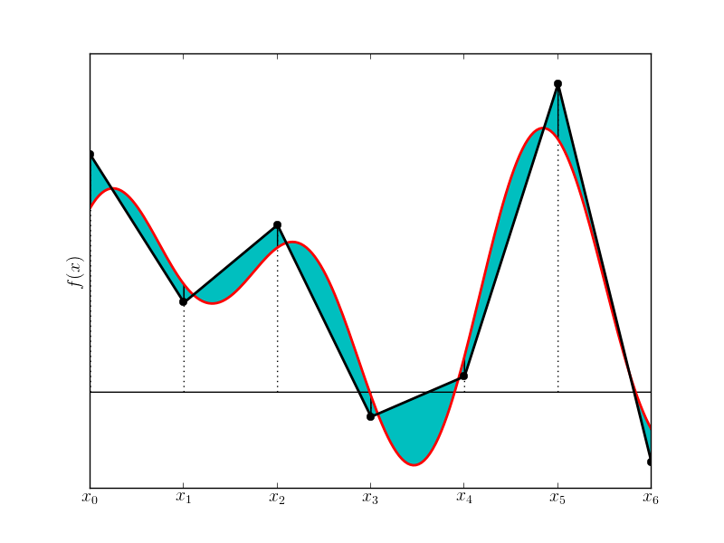
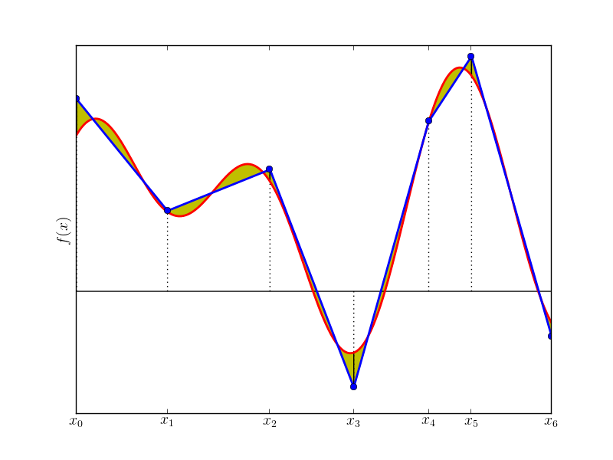
http://jrper.github.io/talks/APS-DFD2014
j.percival@imperial.ac.uk
Motivation: Céa’s Lemma
Mesh Adaptivity– Interpolation Error estimates
For sufficiently nice PDEs and linear (or better) elements
In higher dimensions, error estimate is a function of the Hessian matrix and the edge vectors.
“Mesh metric”

Slide 7
http://jrper.github.io/talks/APS-DFD2014
j.percival@imperial.ac.uk
Mesh Adaptivity – Interpolation
Error Estimates
Problem: we don’t know ψ^{exact}
Answer: Use old ψ^{δ} instead.
Estimate second derivatives from the finite element data
Try to extremize
Where the vs are the edges of the mesh
Additional constraints for
Bounds on min/max edge lengths
Gradation of the increase
Aspect ratios
Metric advection

Slide 8
http://jrper.github.io/talks/APS-DFD2014
j.percival@imperial.ac.uk
Mesh Adaptvity: Error Estimate Optimization
Local remeshing algorithm. Preserve the old mesh in regions where it is adequate.
Apply hr adaptivity in the regions where fixing is necessary: Add, remove nodes, reconnect nodes and move nodes.
Algorithm works iteratively, attacking areas in which edge lengths are far from the ideal calculated from interpolation error estimate and freezing sufficently good elements.
Pain, Umpleby, de Oliveira & Goddard,(2001).
Tetrahedral mesh optimisation and adaptivity for steady-state and transient finite element calculations,
Computer Method in Applied Mechanics & Engineering
Piggott, Farrell, Wilson, Gorman & Pain (2009)
Anisotropic mesh adaptivity for multi-scale ocean modelling
Philosophical Transactions of the Royal Society A

Slide 9
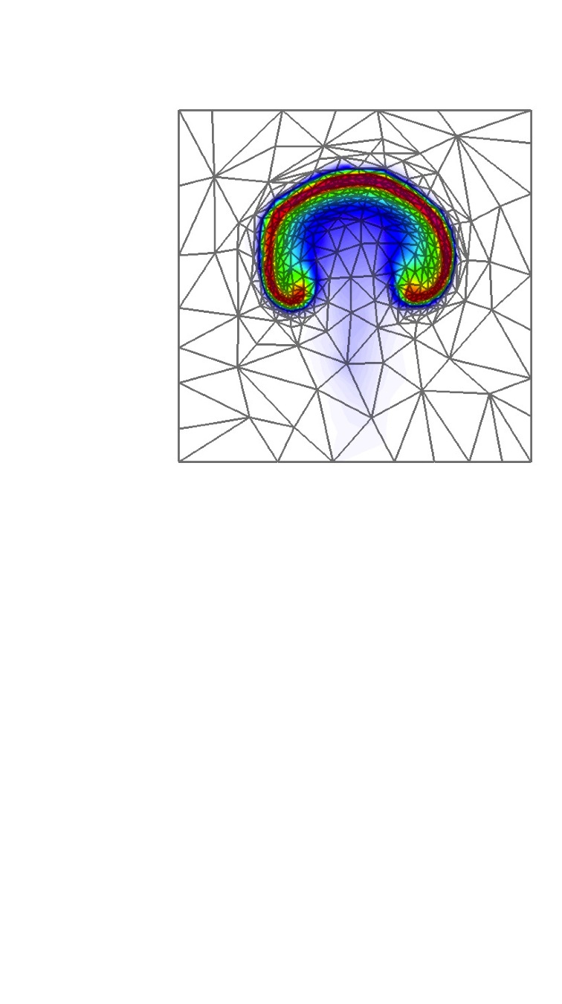
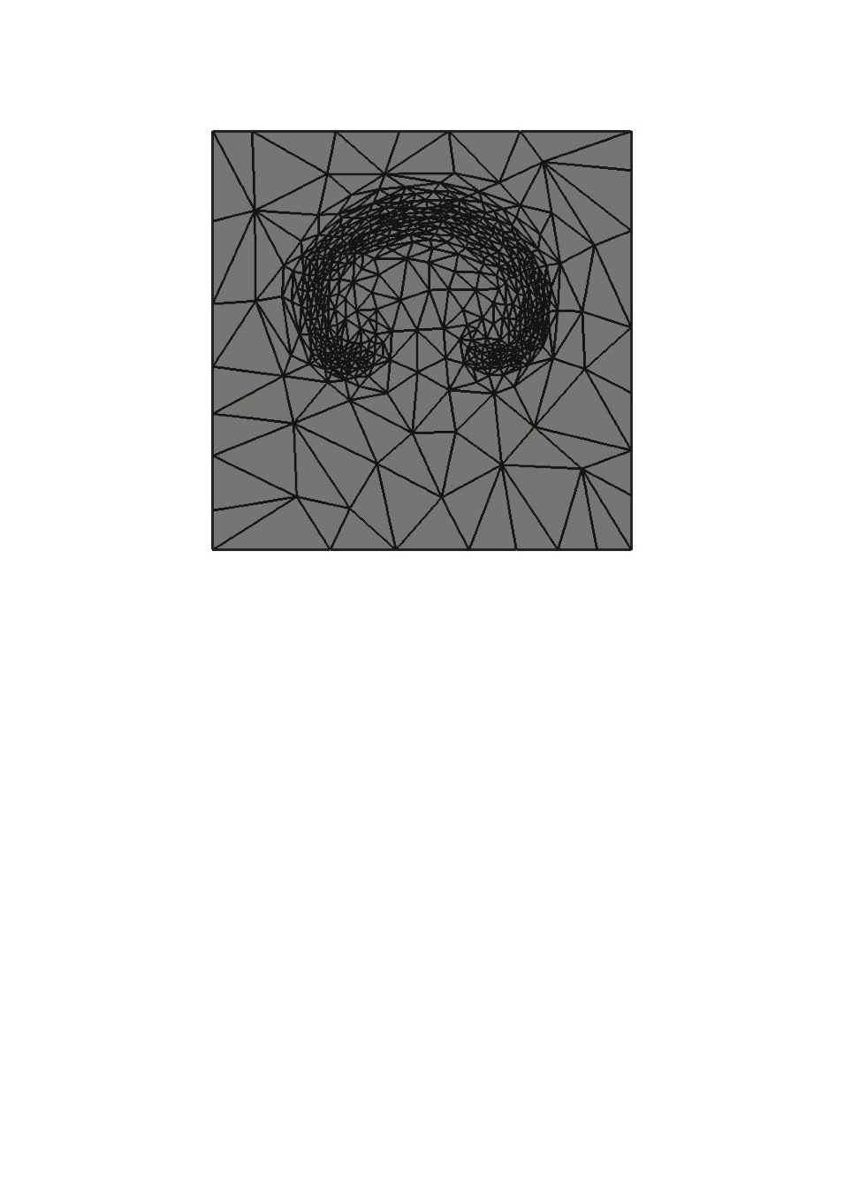
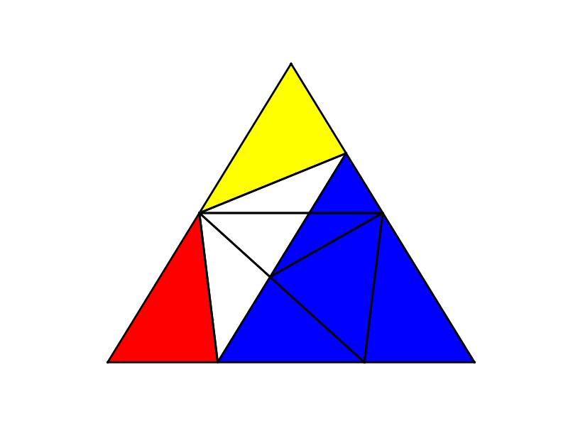
Mesh to mesh interpolation - supermeshing
http://jrper.github.io/talks/APS-DFD2014
j.percival@imperial.ac.uk
FE solutions/test functions piecewise smooth over mesh elements
Elements of supermesh: old variables and new test fns both smooth.
No jumps.
Allows efficient conservative mesh to mesh interpolation via projection methods
P. E. Farrell & J. R. Maddison (2011)
Computer Methods in Applied
Mechanics and Engineering

Slide 10
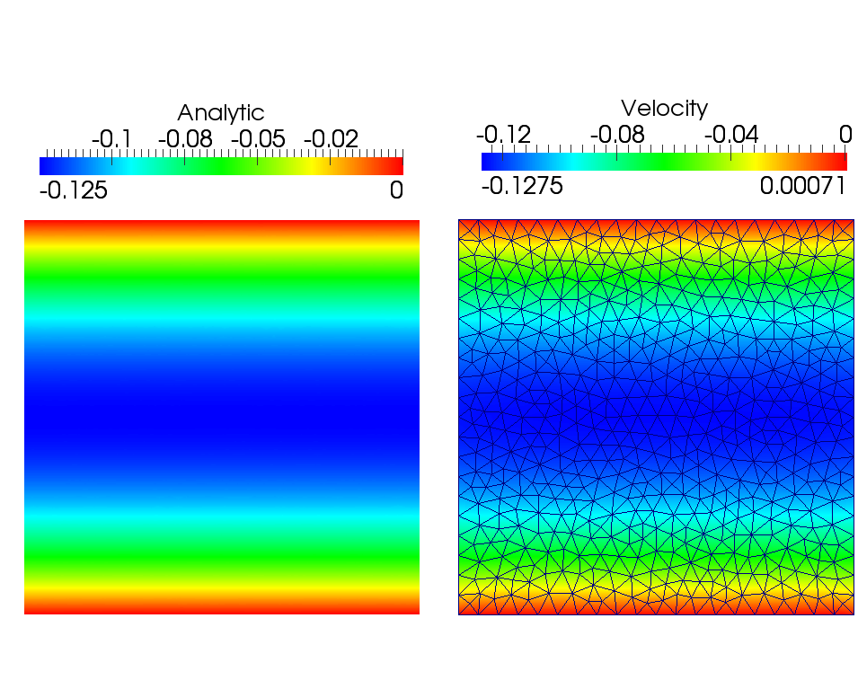
Single Phase Newtonian flow
Single phase laminar channel flow
Spin up from
Pressure differential

Slide 11
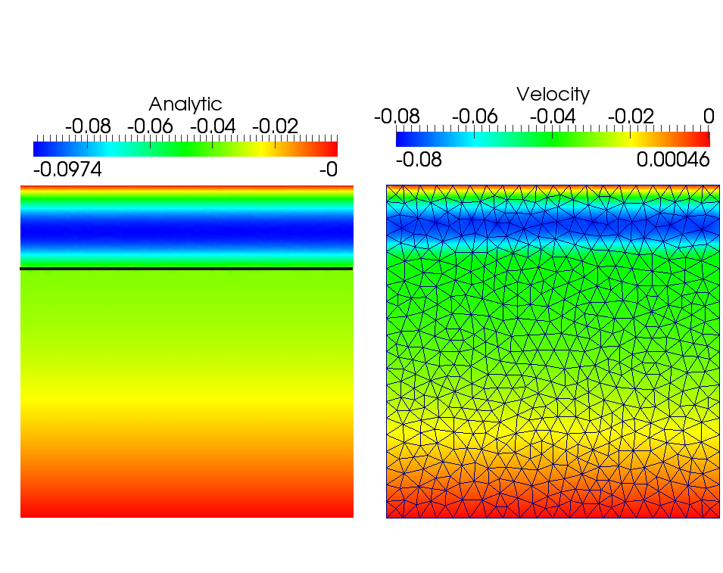
http://jrper.github.io/talks/APS-DFD2014
j.percival@imperial.ac.uk
Two phase Newtonian flow
multiphase laminar channel flow
Spin up from
Pressure differential
Newtonian Fluid
Newtonian Fluid

Slide 12
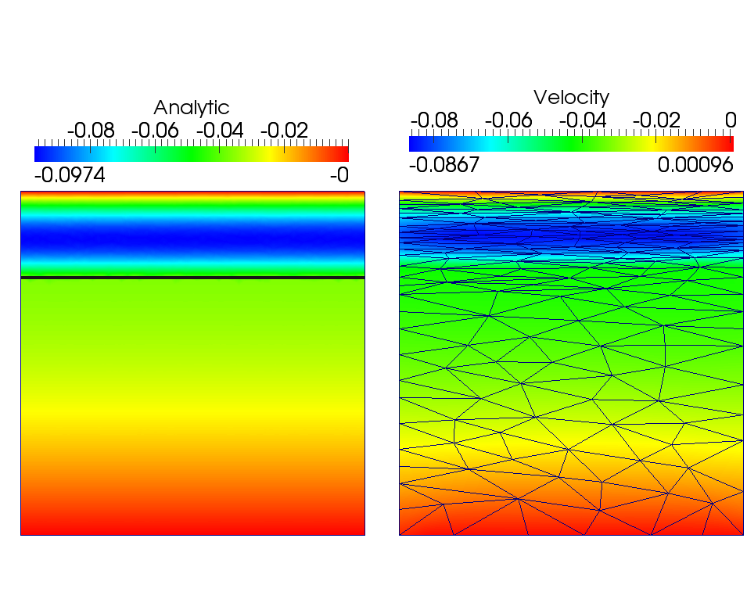
http://jrper.github.io/talks/APS-DFD2014
j.percival@imperial.ac.uk
Two phase Newtonian flow
multiphase laminar channel flow
Spin up from
Pressure differential

Slide 13
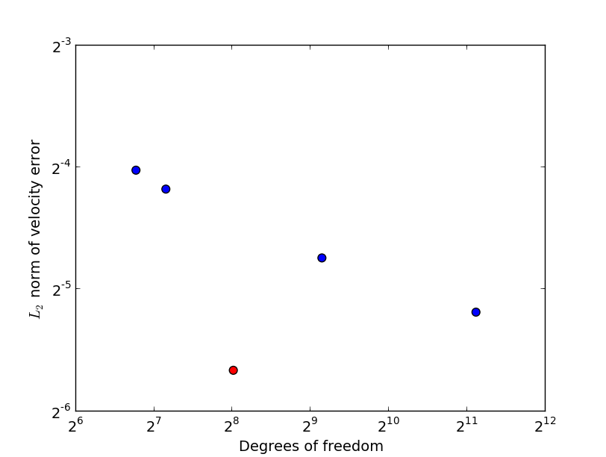
Convergence rates and error reduction
http://jrper.github.io/talks/APS-DFD2014
j.percival@imperial.ac.uk

Slide 14
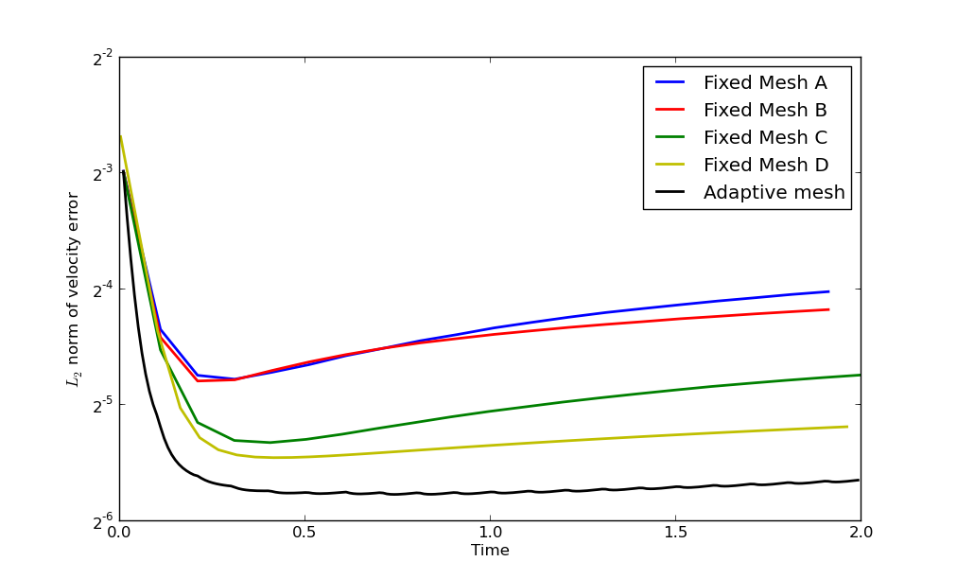
Temporal convergence to steady state
http://jrper.github.io/talks/APS-DFD2014
j.percival@imperial.ac.uk

Slide 15
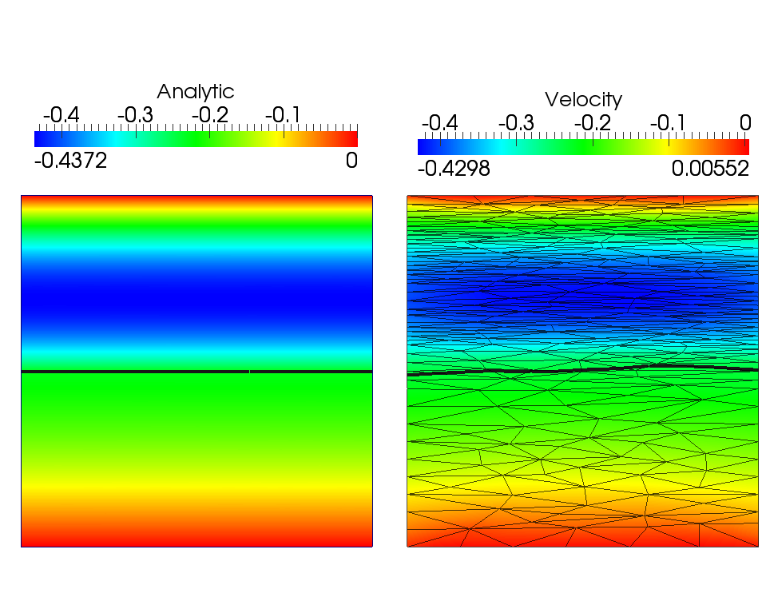
Non-Newtonian Rheologies
http://jrper.github.io/talks/APS-DFD2014
j.percival@imperial.ac.uk
multiphase laminar channel flow : power law
Newtonian Fluid
Power law fluid

Slide 16
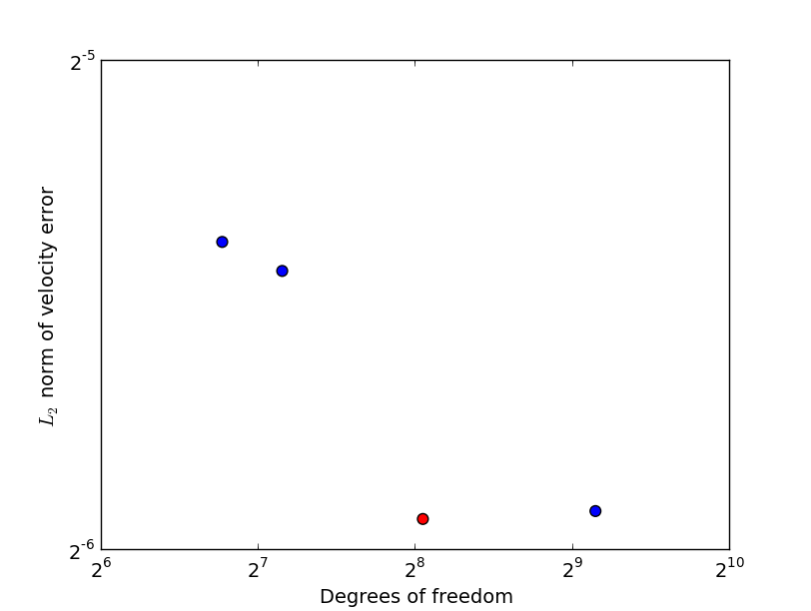
Convergence rates and error reduction
http://jrper.github.io/talks/APS-DFD2014
j.percival@imperial.ac.uk

Slide 17
Carreau fluids

Slide 18
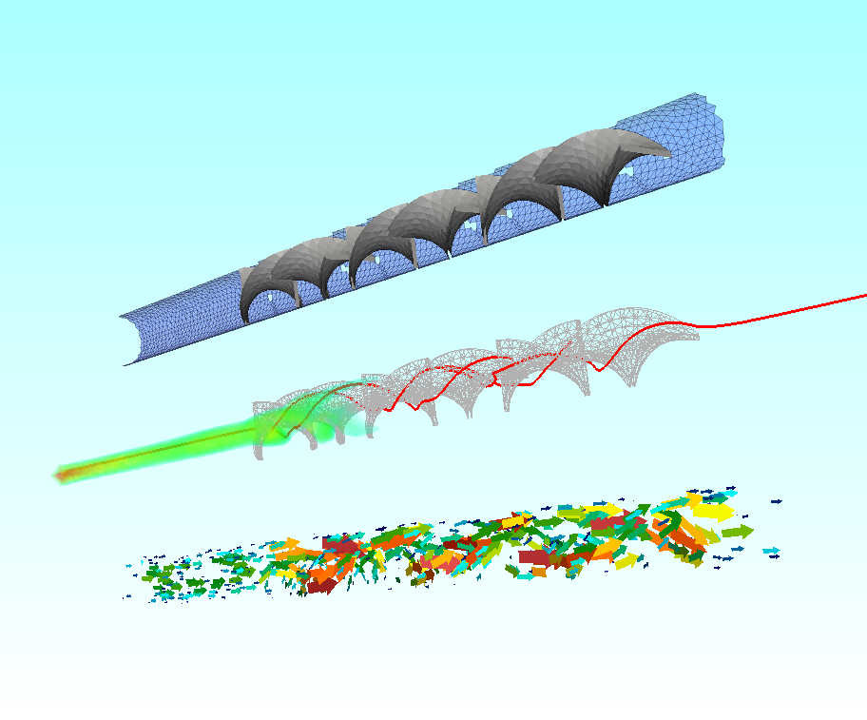
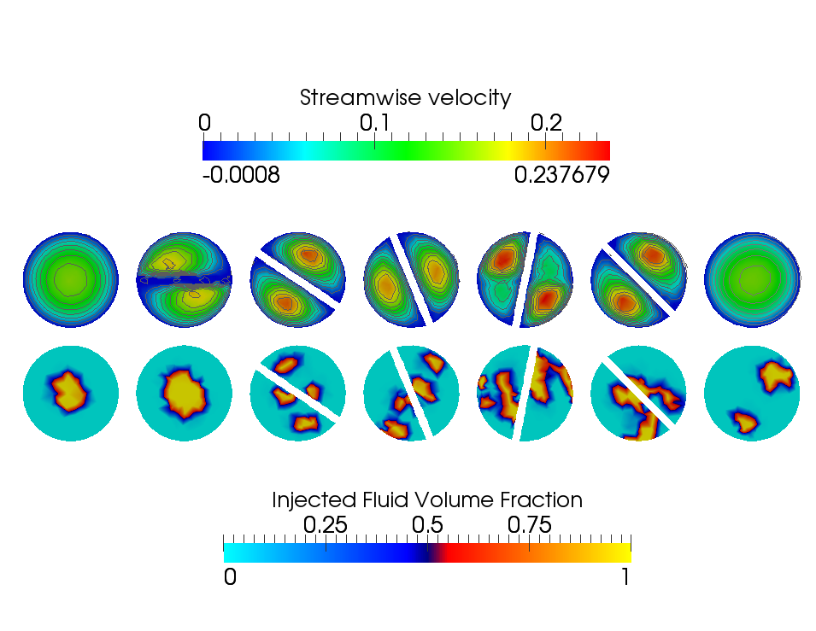
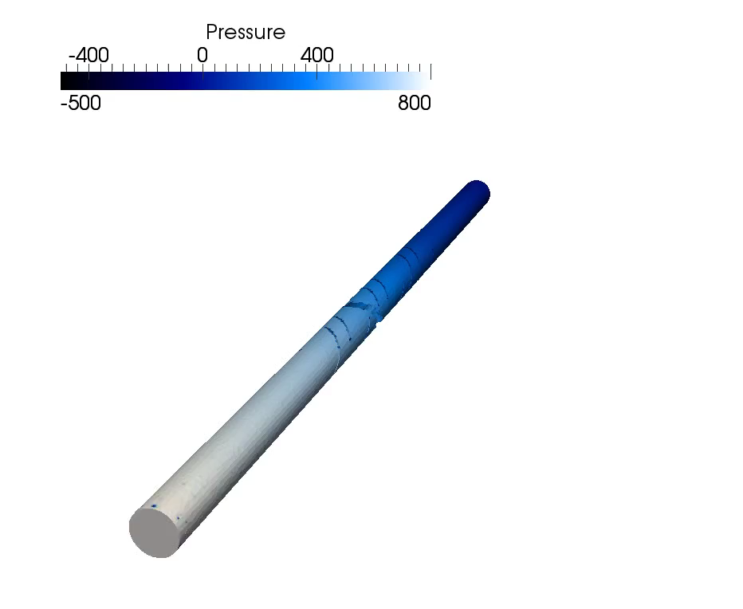
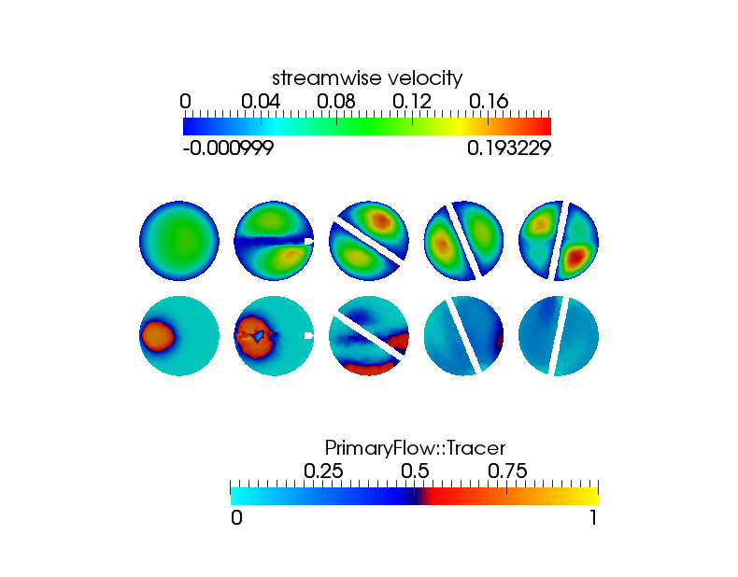
3D problems in non-idealized geometries
http://jrper.github.io/talks/APS-DFD2014
j.percival@imperial.ac.uk

Slide 19
Other Rheologies
viscoelastic stress model
Oldroyd B
Adds fluid memory term
Includes rotational terms for convection of local coordinate
Polymers & Boger fluids

Slide 20



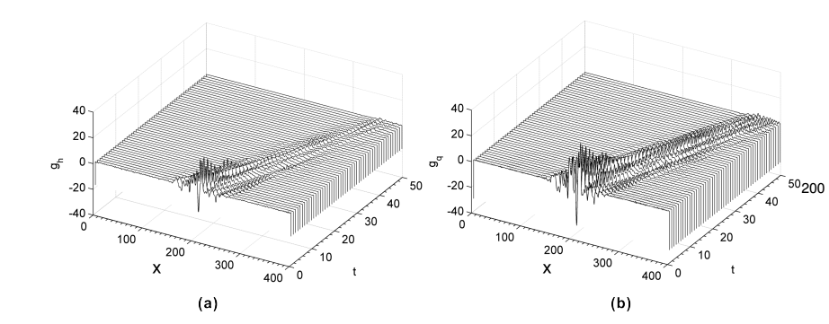
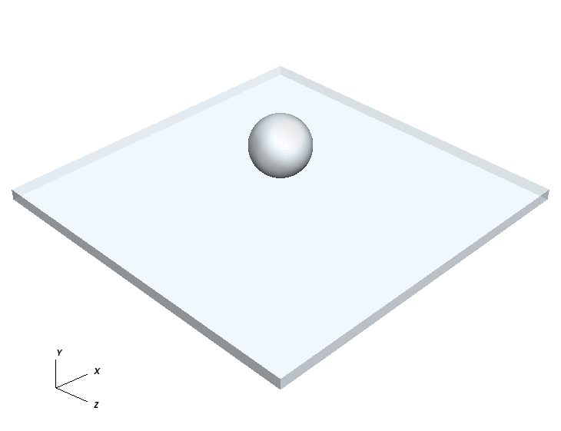
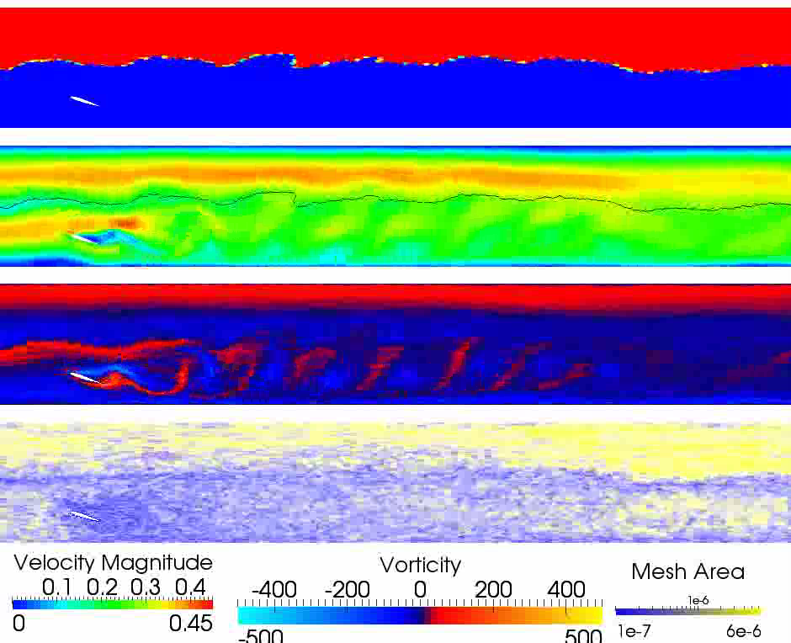

Upcoming MEMPHIS talks @ APS-DFD
www.memphis-multiphase.org
Studies of Interfacial Perturbations in Two Phase Oil-Water Pipe Flows Induced by a Transverse Cylinder
Numerical study of Taylor bubbles with adaptive unstructured meshes
Optimisation of sensor locations for falling film problems based on importance maps
Dr. Maxime
Chinaud
Dr. Zhihua
Xie
Dr. Zhizhao
Che
M22.8
R33.1
R35.9
Slides available from http://jrper.github.io/talks/APS-DFD2014

